Slide 1
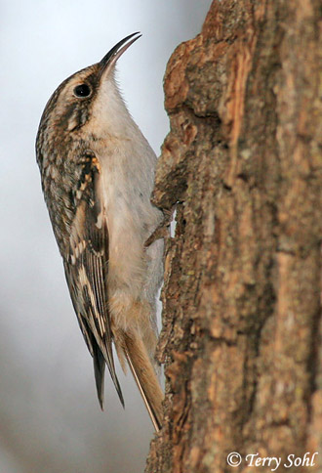
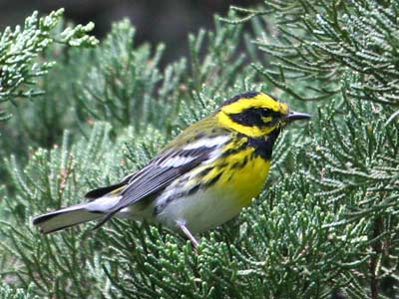
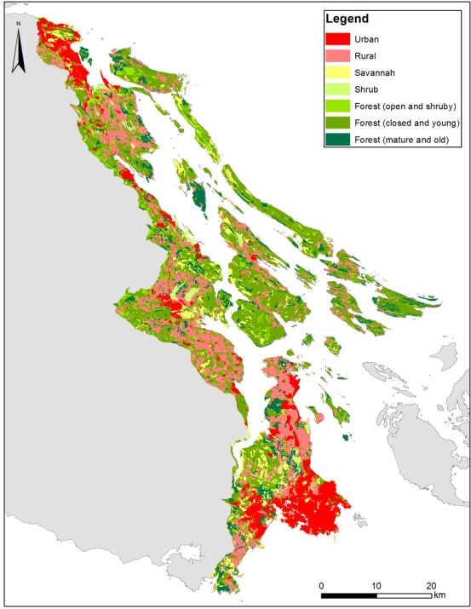
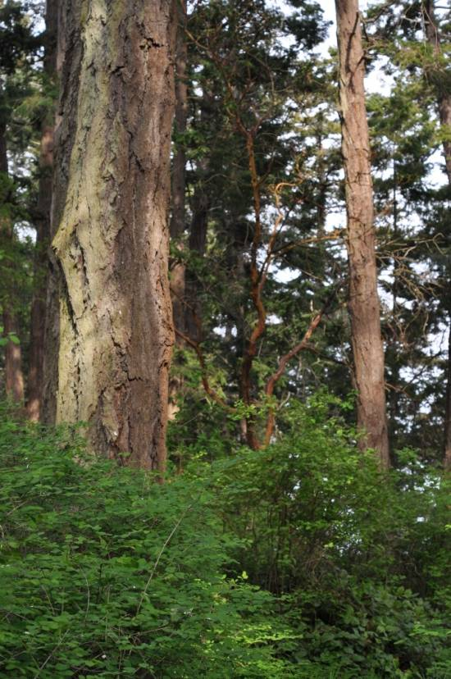
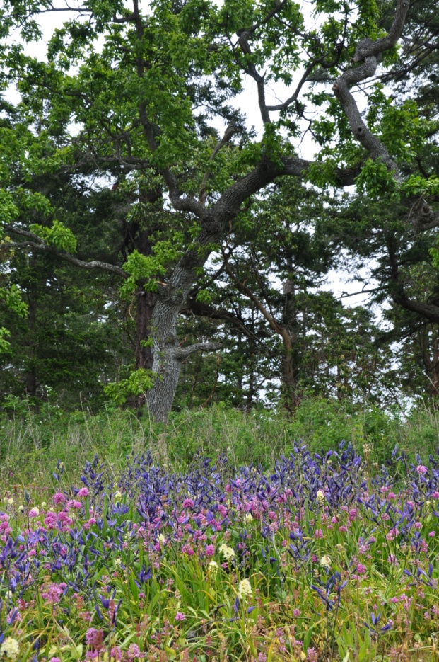
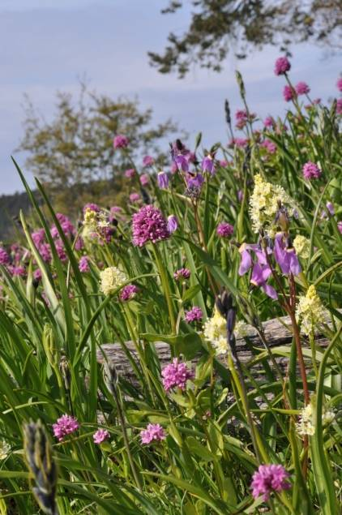
Decision-making, Landscape Context and Long-term management Cost in the Coastal Douglas Fir Zone
Notes:
In the Douglas Fir/Garry Oak Woodlands of coastal BC, we are using SCAD to prioritize investments in land conservation, but doing so in a landscape were no ‘intact’ old-growth habitat remains. This raises the interesting question of where to start. In this talk, we’d like to attract your feedback on an evolving approach we are using to prioritize areas for the restoration of ‘old growth’ ecosystems, under the assumption that the best restoration candidates are those areas that currently support the richest communities of species thought to rely on historic habitat attributes.

Slide 2
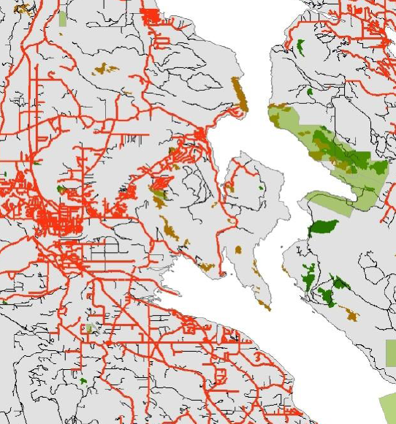
A Classic Approach to Prioritizing Sites for Conservation
Biogeographic ‘Rules of Thumb’
Assume Largest Relict Communities (SEI) Support Richest Most Viable Communities
2) Prioritize Unprotected Sites Where ‘Threat’ and ‘Urgency’ are Highest

Slide 3
Alternative Approaches to Prioritization
Planning ‘Rules of Thumb’
1) Largest Relict Sites Support the Richest, most Viable Communities
2) Prioritize Sites where ‘Threat’ and ‘Urgency’ are Highest
Context Drives Success
Sites Most Isolated from Human Influence Support the Richest Most Viable Communities
Prioritize Sites where Threats are Minimized and Native Species Richness and ‘Integrity’ are Maximized
≠
≠
Which Approach Works Best in the CDF?

Slide 4
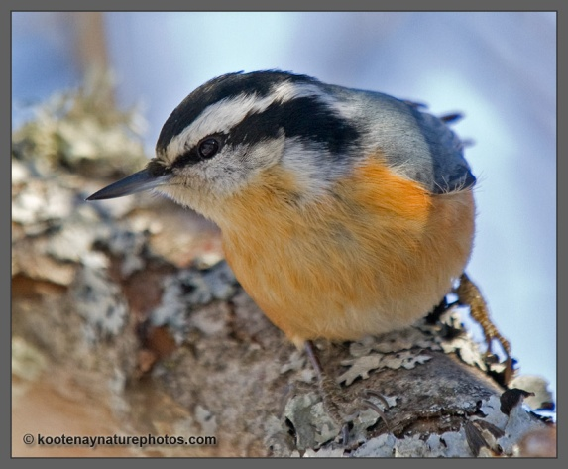
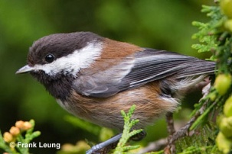
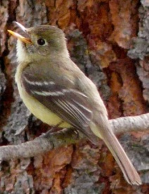
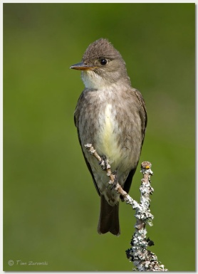
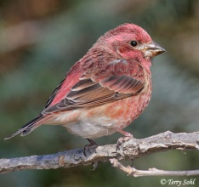
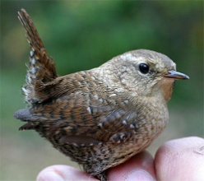
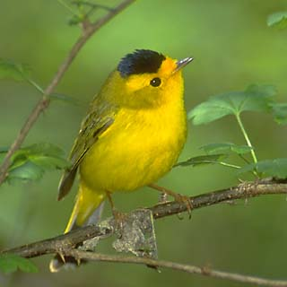
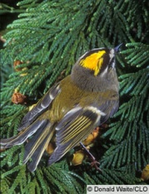
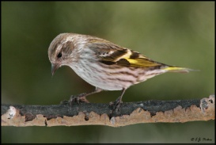
Forest Reliant Bird Communities
Species | Reliance Score | Map Weight
Brown Creeper | 0.81 | 0.11
Red-breasted Nuthatch | 0.79 | 0.11
Chestnut-backed Chickadee | 0.75 | 0.10
Golden-crowned Kinglet | 0.77 | 0.10
Pacific-slope Flycatcher | 0.63 | 0.09
Pine Siskin | 0.69 | 0.09
Townsend's Warbler | 0.69 | 0.09
Pacific Wren | 0.63 | 0.08
Purple Finch | 0.58 | 0.08
Yellow-rumped Warbler | 0.56 | 0.08
Olive-sided Flycatcher | 0.46 | 0.06
Wilson's Warbler | 0.06 | 0.01
Rufous Hummingbird | -0.07 | -
Song Sparrow | -0.36 | -
Spotted Towhee | -0.03 | -
White-crowned Sparrow | -0.66 | -
Dark-eyed Junco | -0.03 | -
Orange-crowned Warbler | -0.05 | -
Schuster & Arcese 2012, Ecography

Slide 5
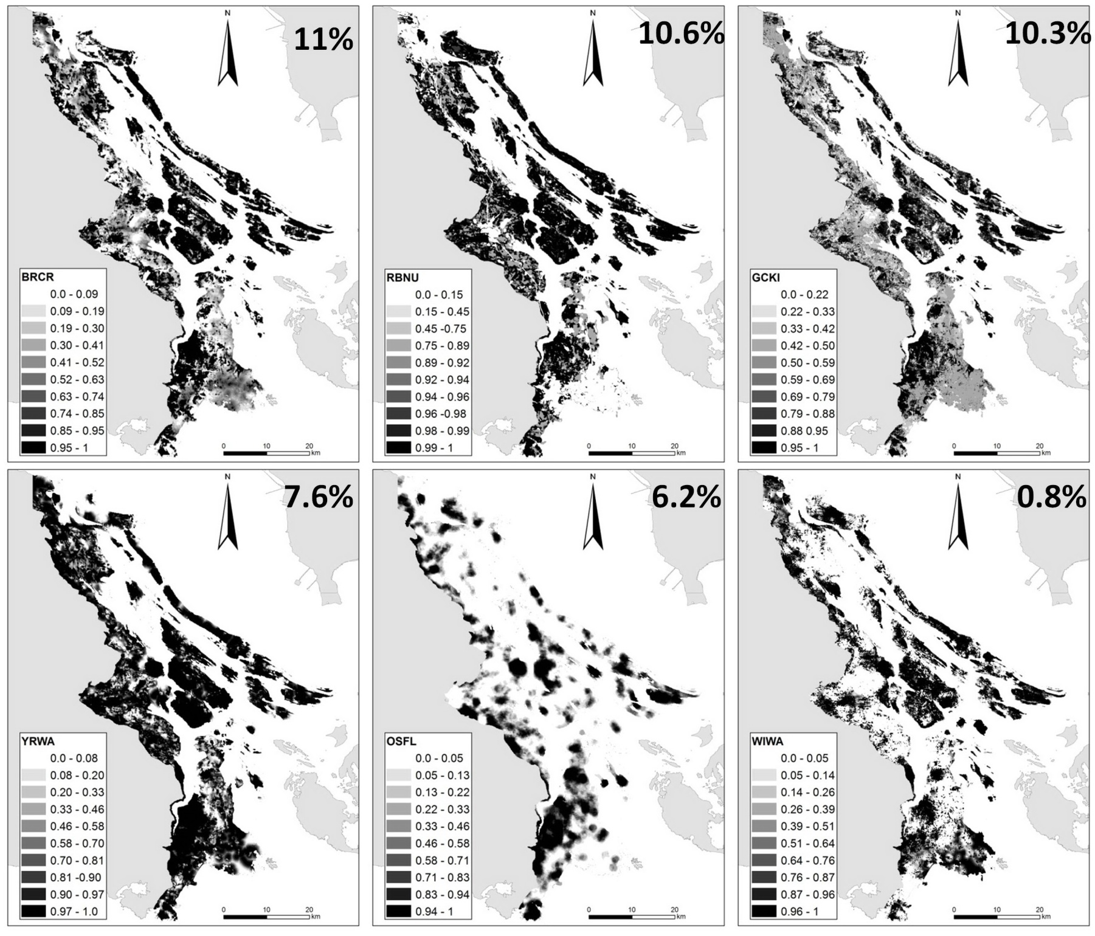
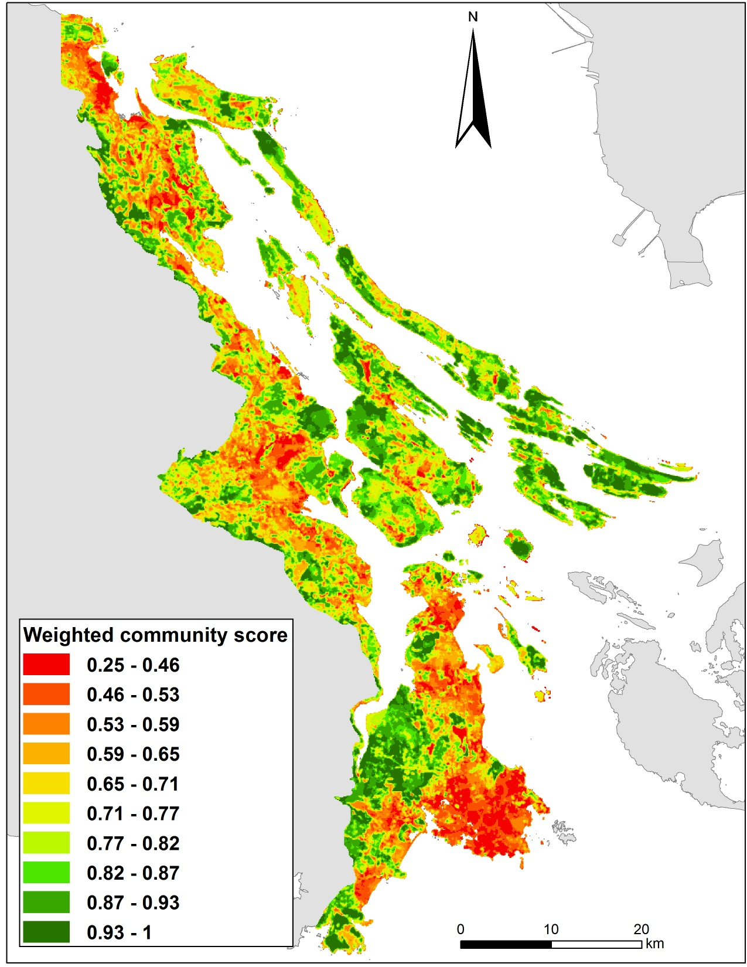
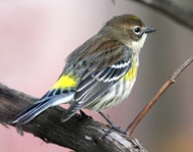
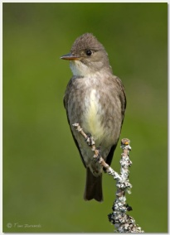
Schuster & Arcese 2012, Ecography

Slide 6
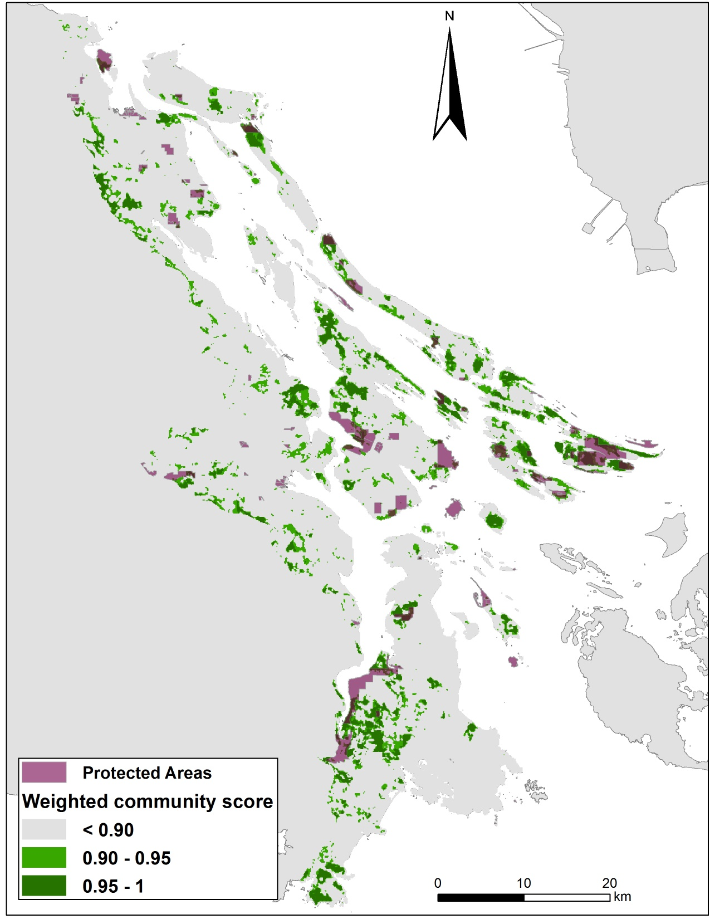
What Predicts the Old Forest Community?
r = -0.42
Schuster & Arcese 2012, Ecography
N = 1248 Forest Stands > 80 yrs of age

Slide 7
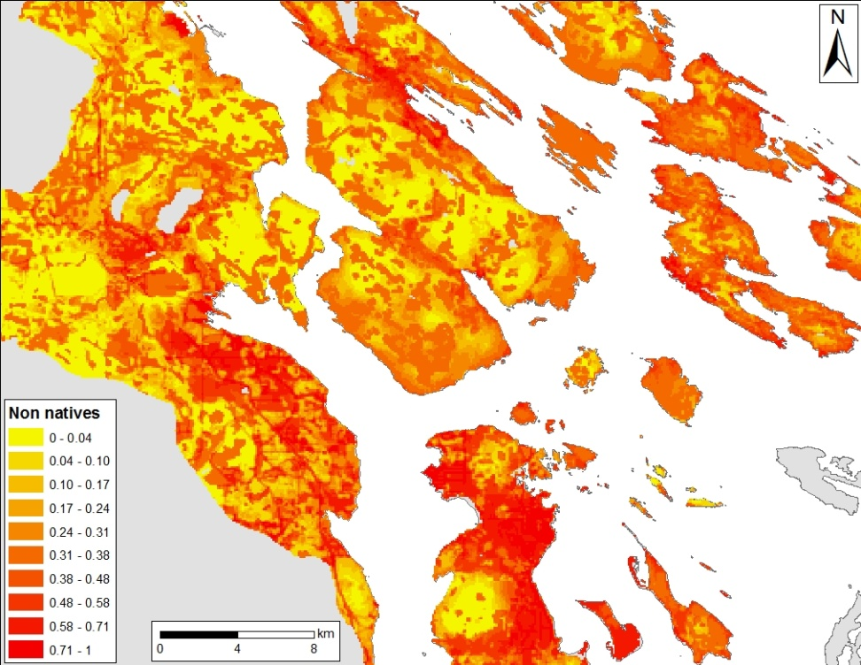
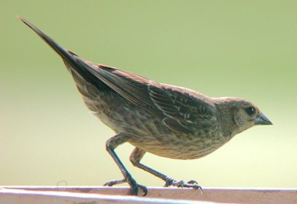
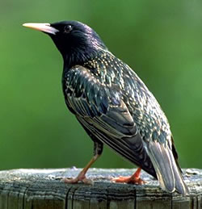
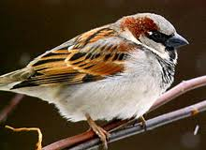
‘Integrity’ of Native Bird Communities
Non-Natives
Brown-headed cowbird
Starling
House Sparrow

Slide 8
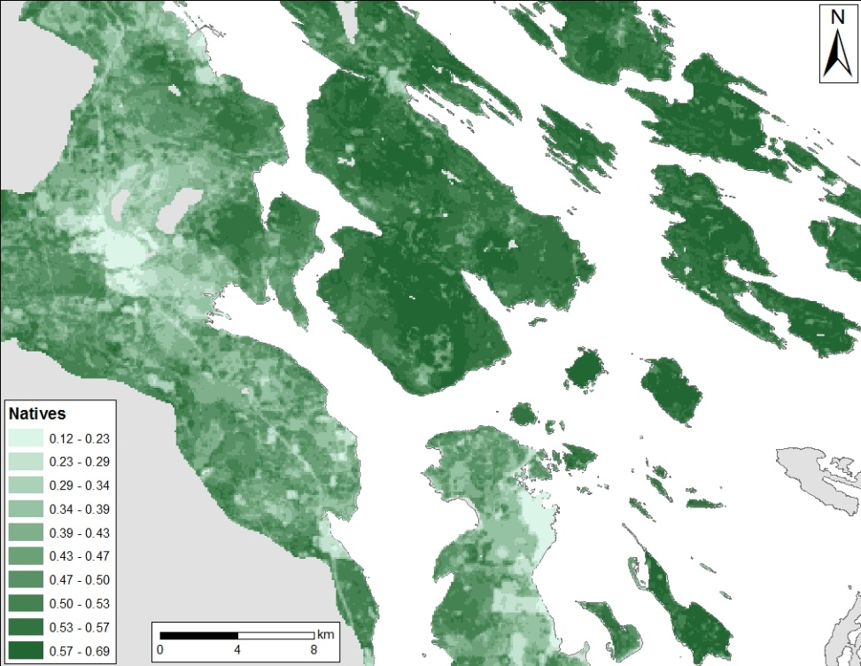
‘Integrity’ of Native Bird Communities
42 Native Species
6 Warblers
6 Sparrows
4 Finches
3 Woodpeckers
3 Flycatchers
3 Swallows
3 Wrens
3 Thrushes
2 Corvid
Hummingbird, Vireo, Kinglet, Creeper, Nuthatch, Chickadee, Tanager, Blackbird, Eagle

Slide 9
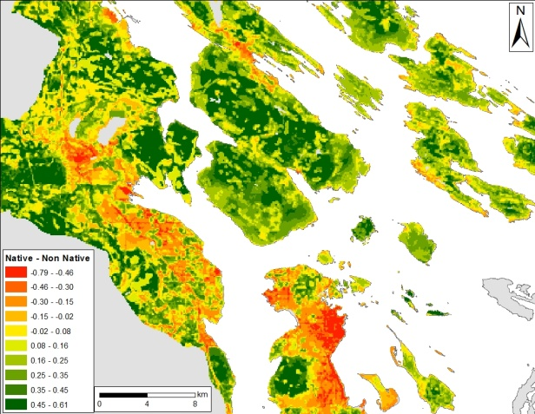
‘Integrity’ of Native Bird Communities
Darker indicates high native-exotic richness
Predictors
Agriculture -
Roads -
Protected +
Isolation +
Patch Area (+)
r² = 0.45, N = 1258

Slide 10
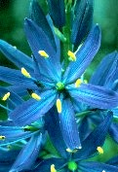
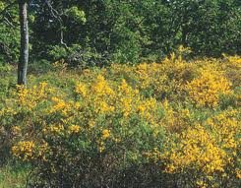
‘Integrity’ of Meadow Communities: 40 Native and Exotic Dominants
Camassia leichtlinii
Festuca rubra
Brodiaea coronaria
Galium aparine
Camassia quamash
Brodiaea hyacinthina
Achillea millefolium
Sanicula crassicaulis
Plectritis congesta
Elymus glaucus
Collinsia parviflora
Polypodium glycyrrhiza
Luzula multiflora
Cerastium arvense
Lotus micranthus
Ranunculus occidentalis
Danthonia californica
Carex inops
Trifolium willdenowii
Lomatium utriculatum
Aira praecox
Hypochaeris radicata
Anthoxanthum odoratum
Rumex acetosella
Vicia sativa
Holcus lanatus
Bromus diandrus
Vulpia bromoides
Cytisus scoparius
Stellaria media
Bromus hordeaceus
Bromus sterilis
Geranium molle
Dactylis glomerata
Vicia hirsuta
Veronica arvensis
Cynosurus echinatus
Myosotis discolor
Poa pratensis
Aphanes arvensis/australis

Slide 11
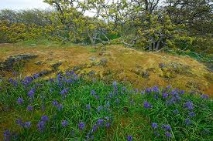
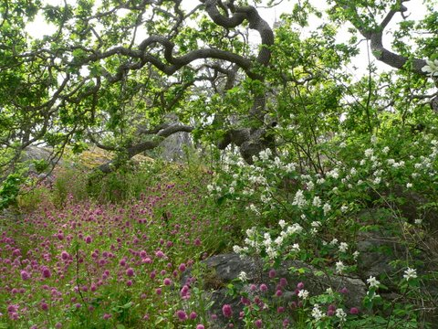
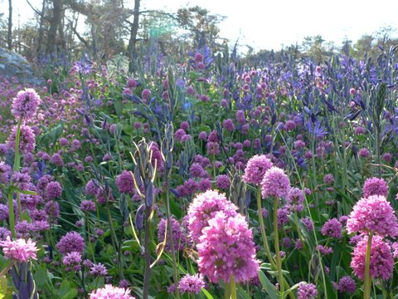
How are Conservation Priorities Affected by Restoration and Management Cost in Future?
Shallow-soil, shedding sites not succeeding to closed forest in the absence of fire (drought-maintained community)

Slide 12
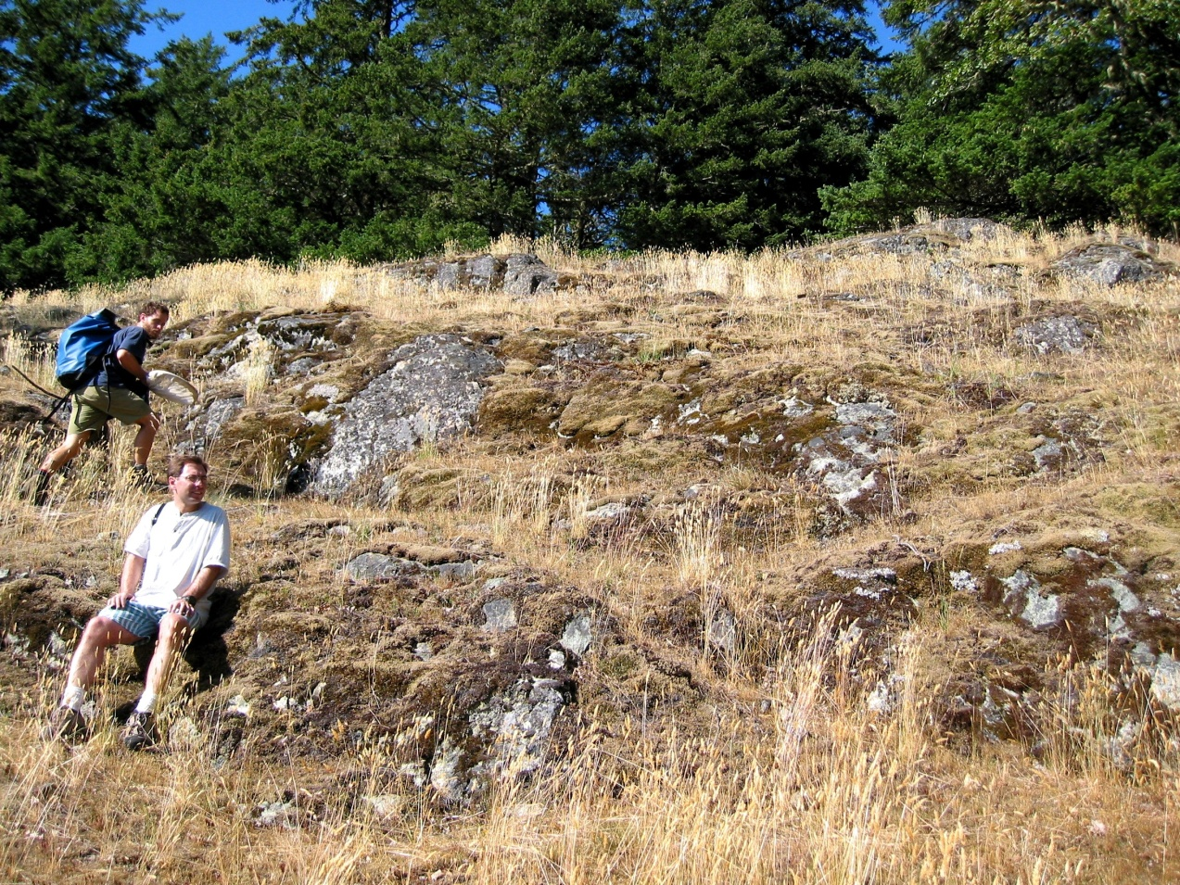
How Do Restoration Costs Vary with Degree of Invasion?
High Native Cover vs High Exotic Cover

Slide 13
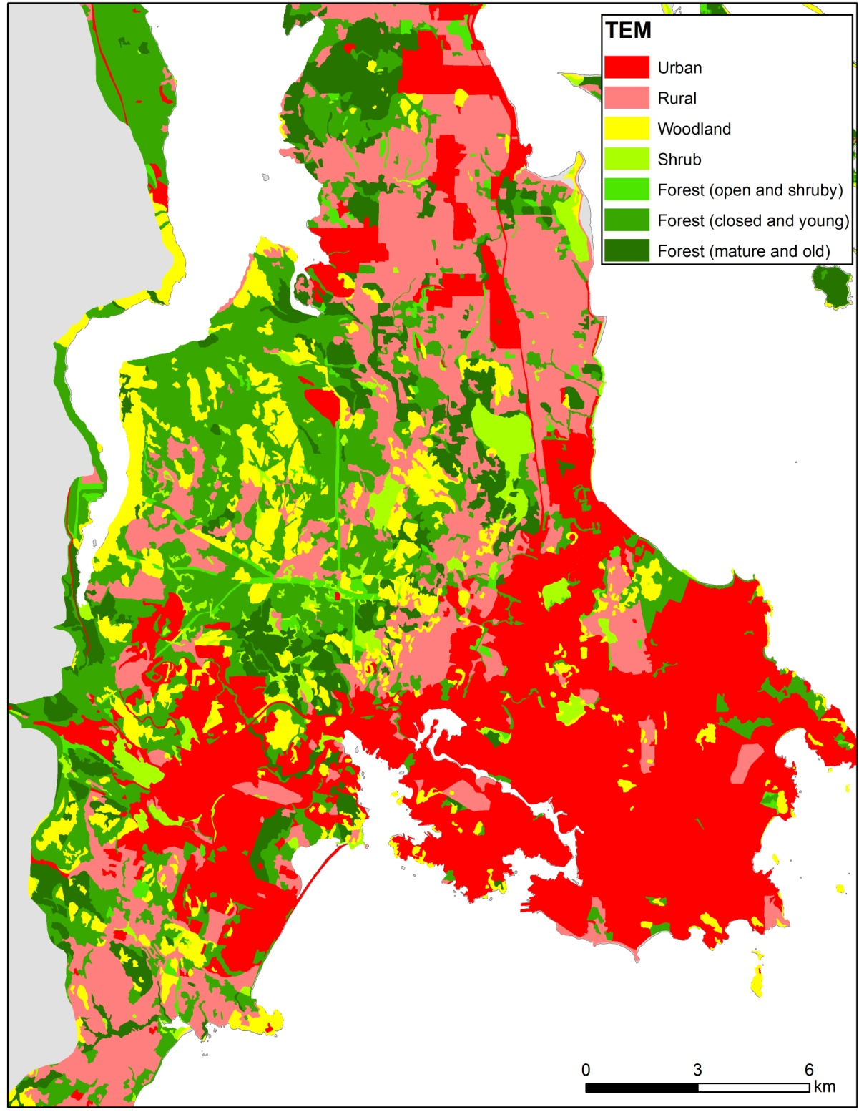
How Might Long-term Management Costs Influenced by Landscape Context?
How Might We Employ our Expertise to Prioritize Management Actions?

Slide 14
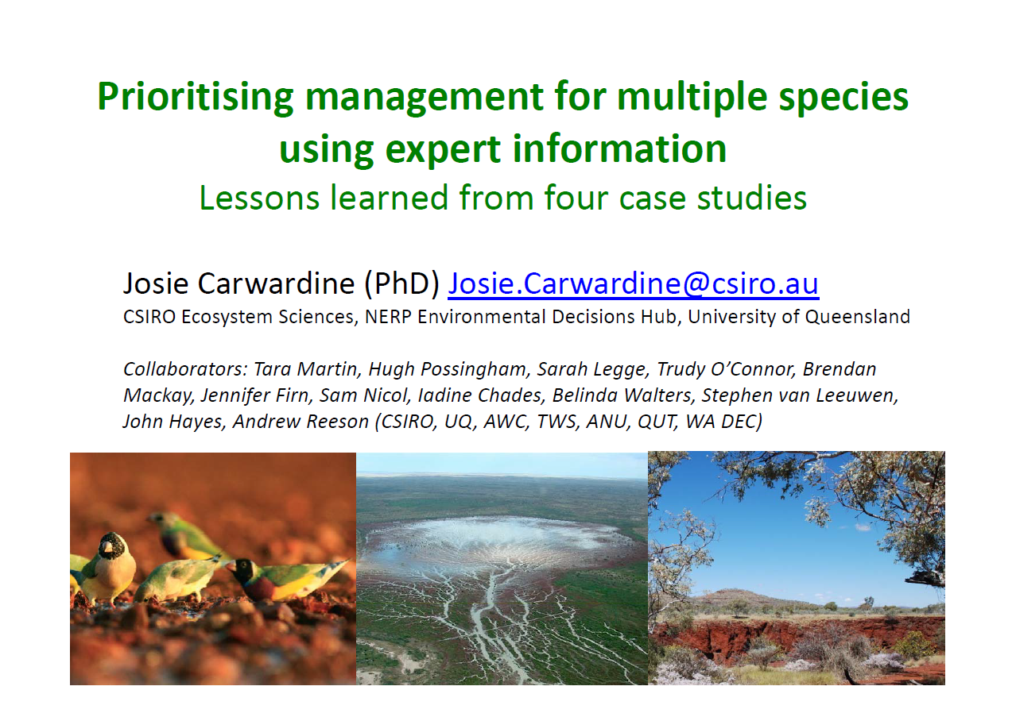

Slide 15
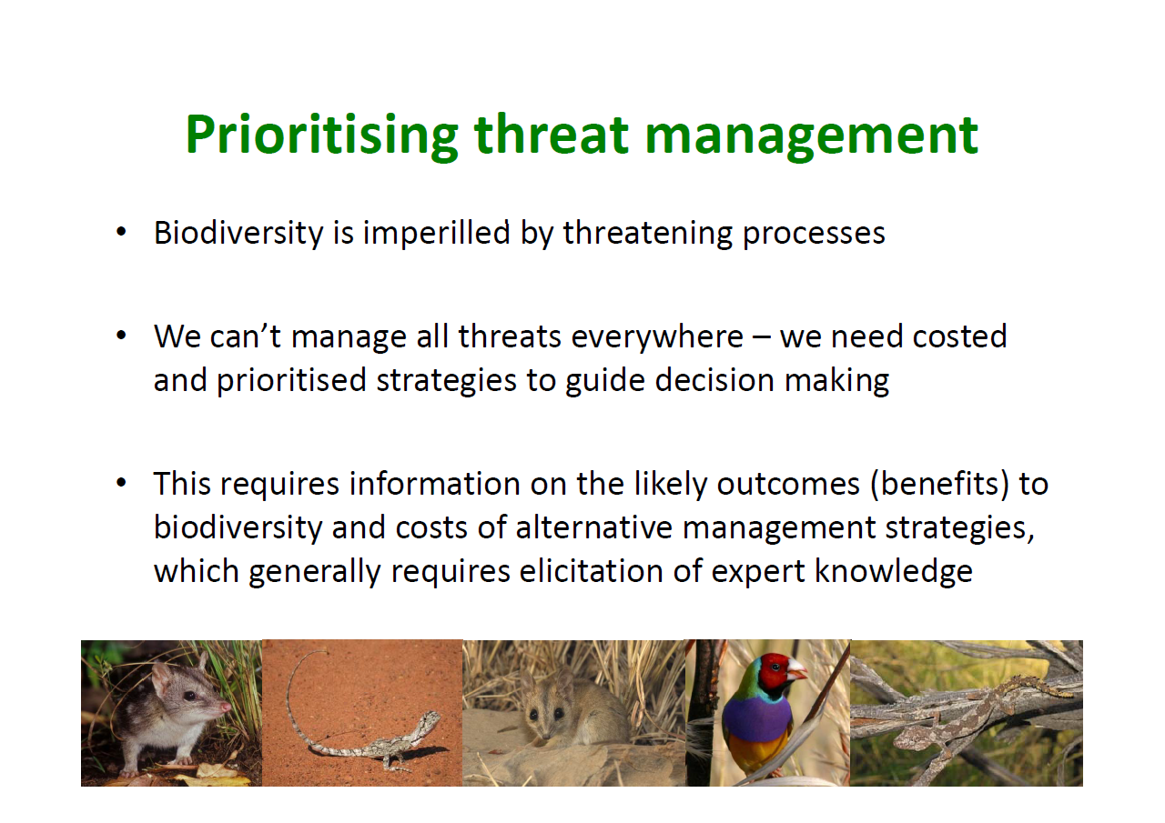

Slide 16
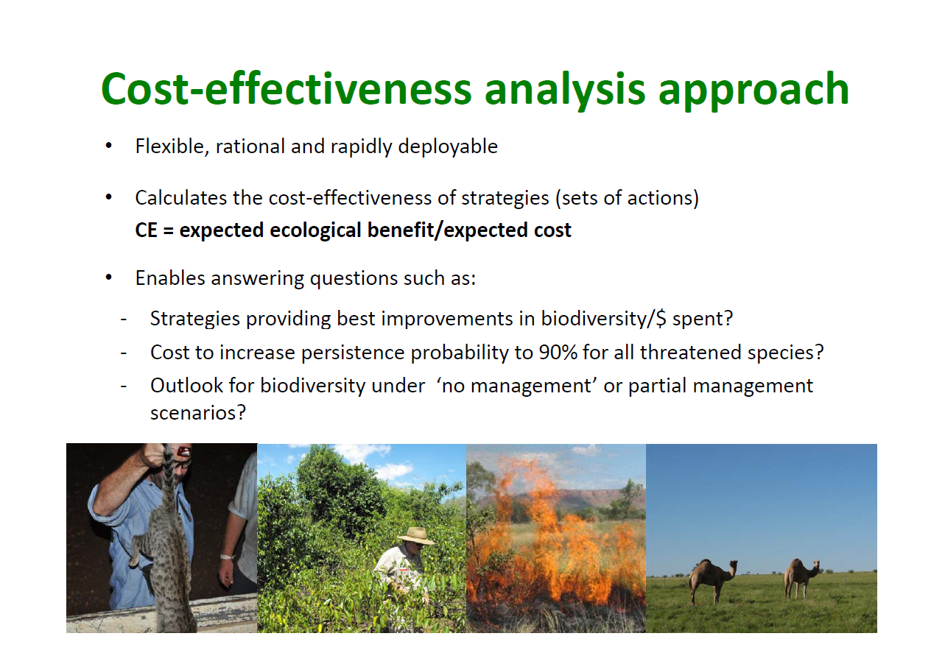

Slide 17
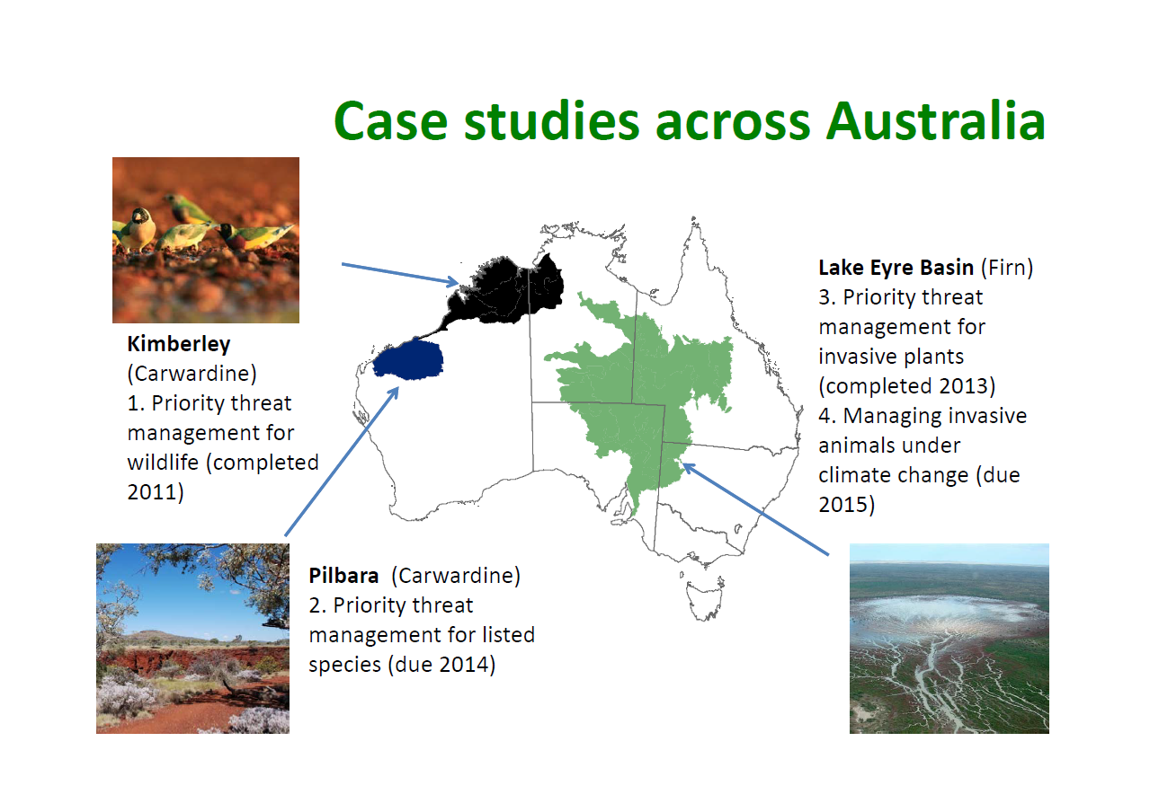

Slide 18
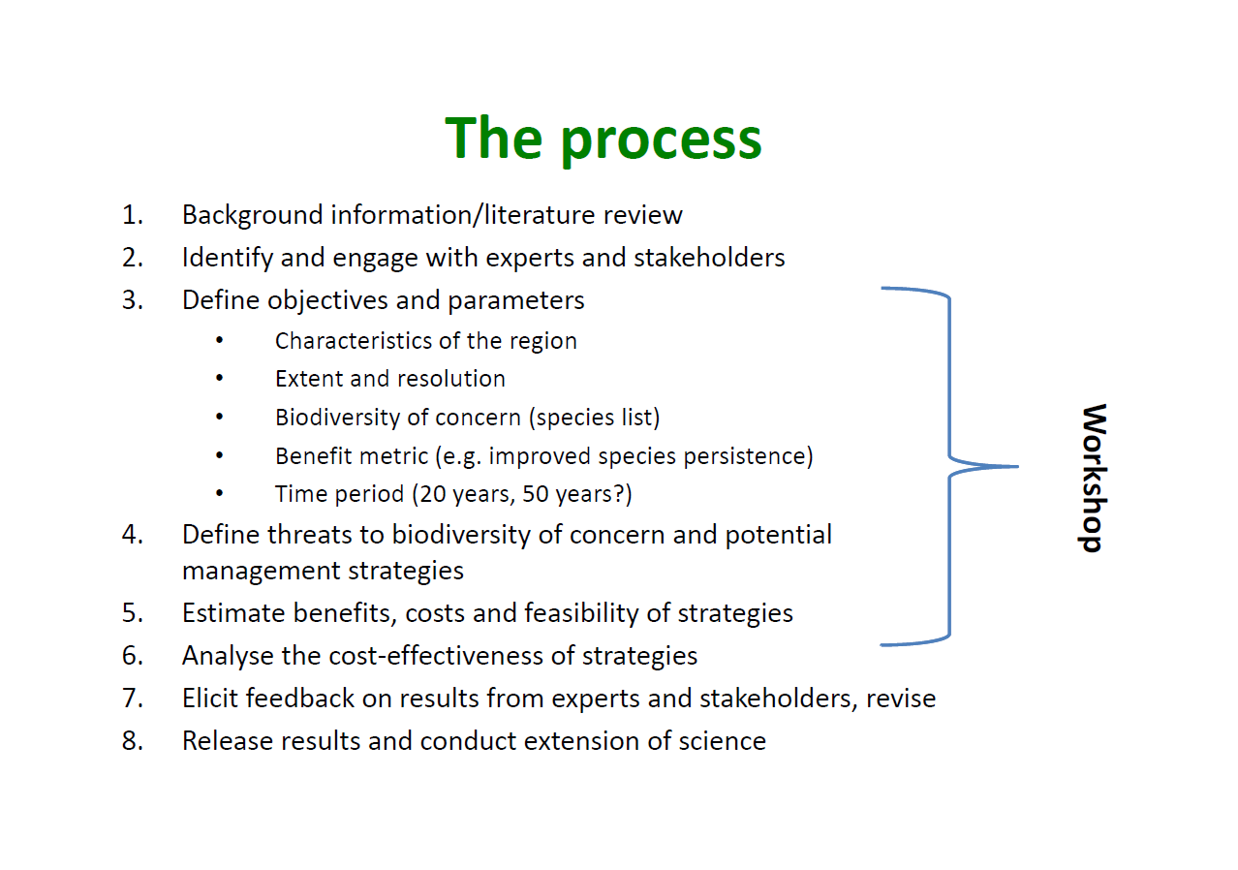

Slide 19
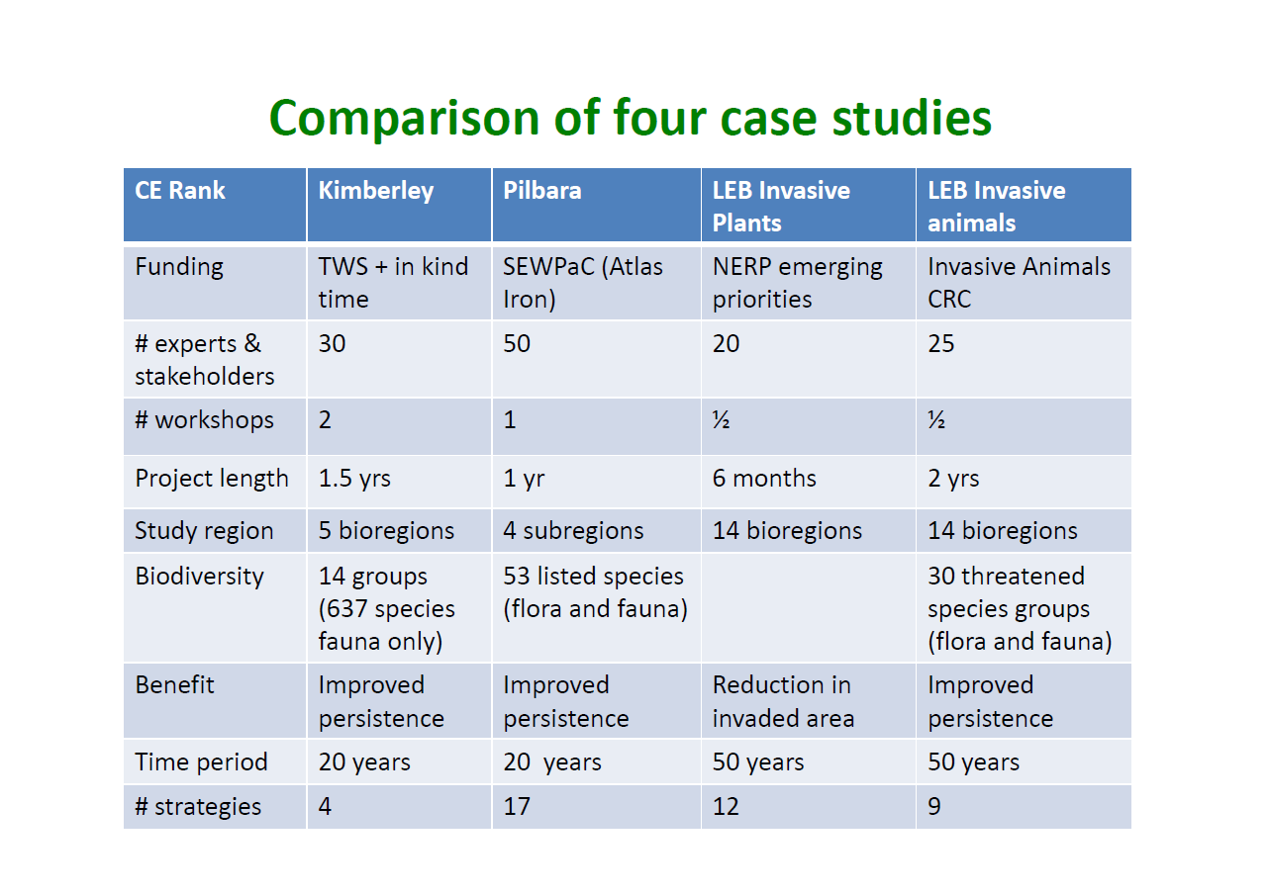

Slide 20
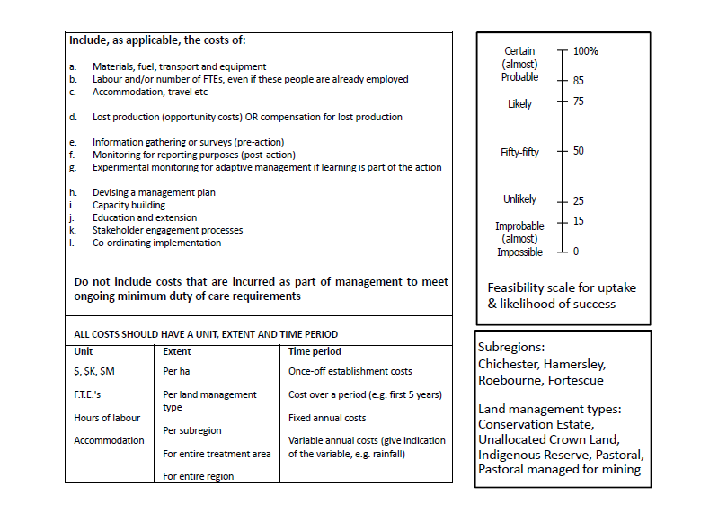

Slide 21
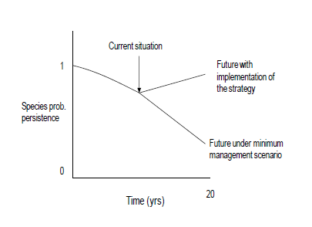
Estimating the Benefits of An Action
Estimate the cost of the action, given benefit and feasibility

Slide 22
How Do Restoration Costs Vary with Degree of Invasion?
High Native Cover vs High Exotic Cover

Slide 23
Highest Benefit in Sites with moderate invasion but little rural-urban habitat with 1 km buffer
Lowest in Sites with High Invasion and rural-urban with 1 km

Slide 27
 | Shrub Cut + Remove Benefit | Invasion (j) + Threat (k) Combinations | Biodiversity Benefit | Feasibility | Long-term Cost
X-Axis | A | B | C | D | E | Avg | Stdev
j: <5; k: <5 | 0.5 | 0.75 | 0.15 | 0.5 | 0.7 | 0.52 | 0.24
j: <5; k: 5-20 | 0.6 | 0.7 | 0.1 | 0.45 | 0.75 | 0.52 | 0.26
j: <5; k: 20-40 | 0.7 | 0.75 | 0.25 | 0.4 | 0.7 | 0.56 | 0.22
j: <5; k: >40 | 0.8 | 0.75 | 0.25 | 0.2 | 0.75 | 0.55 | 0.30
j: 5-20; k: <5 | 0.9 | 0.7 | 0.85 | 0.6 | 0.8 | 0.77 | 0.12
j: 5-20; k: 5-20 | 1 | 0.6 | 0.75 | 0.5 | 0.8 | 0.73 | 0.19
j: 5-20; k: 20-40 | 0.75 | 0.75 | 0.6 | 0.4 | 0.7 | 0.64 | 0.15
j: 5-20; k: >40 | 0.75 | 0.75 | 0.5 | 0.2 | 0.7 | 0.58 | 0.24
j: 20-40; k: <5 | 0.75 | 0.35 | 0.75 | 0.5 | 0.8 | 0.63 | 0.20
j: 20-40; k: 5-20 | 0.75 | 0.3 | 0.6 | 0.4 | 0.8 | 0.57 | 0.22
j: 20-40; k: 20-40 | 0.5 | 0.4 | 0.5 | 0.3 | 0.7 | 0.48 | 0.15
j: 20-40; k: >40 | 0.5 | 0.4 | 0.5 | 0.1 | 0.7 | 0.44 | 0.22
j: >40; k: <5 | 0.5 | 0.07 | 0.75 | 0.3 | 0.6 | 0.444 | 0.27
j: >40; k: 5-20 | 0.5 | 0.05 | 0.5 | 0.2 | 0.6 | 0.37 | 0.24
j: >40; k: 20-40 | 0.5 | 0.1 | 0.5 | 0.1 | 0.4 | 0.32 | 0.21
j: >40; k: >40 | 0.5 | 0.1 | 0.25 | 0 | 0.4 | 0.25 | 0.21

Slide 28
How Might Landscape Context Influence the Cost of Alternative Acquisitions?
Example Criteria (benefits and costs of acquiring these sites)?
Area of Mature Forest
Viability (Size, Surrounding area)
Representation
Protected areas

Slide 29
Monday
First hour – project completion
Second hour - 4 group presentations (volunteers get 2% bonus on final project for Monday presentation – sign-up via e-mail to Peter)
Tuesday – remaining groups
Rules of Engagement
6 minutes + 4 minutes for questions
6 sides – readable, concise text and legends
- Rational/explanation for mapped species/communities
- Criteria used to reduce candidate sites to selected sites
- Example map showing more and less preferred sites to support criteria above

